Slide 1
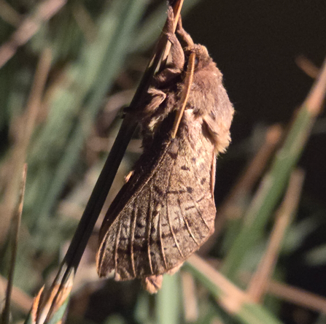
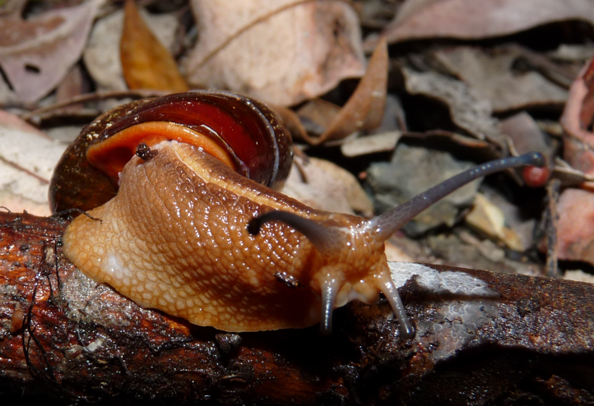
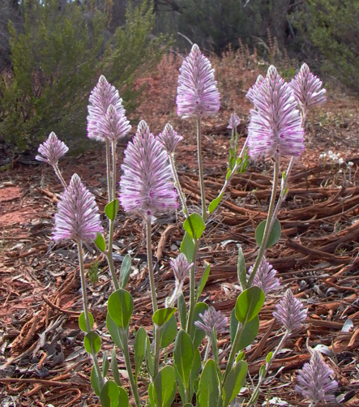





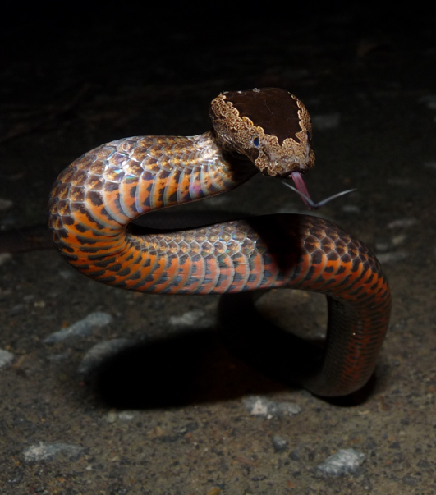
Working Session: Sensitive Species Restricted Access Species Data Extension Task Group 2026
Presenters: Cam Slatyer, Simon Sherrin, Mieke Strong, Tania Laity
Convening Group: Cameron Slatyer, Tania Laity, Piers Higgs, Andrew Rodrigues
We acknowledge the Traditional Owners of the land on which we work. We pay our respects to their Elders past and present and recognise their continuing connection and custodianship of the lands, seas, and waters throughout Australia.
The ALA is the AU node of GBIF, and receives support from the Australian Government through the National Collaborative Research Infrastructure Strategy (NCRIS) and is hosted by the Commonwealth Scientific and Industrial Research Organisation (CSIRO).
All images are licensed under the Creative Commons Attribution 4.0 International licence CC BY NC
All other slide content is licensed under the Creative Commons Attribution 4.0 International licence CC BY

Slide 2
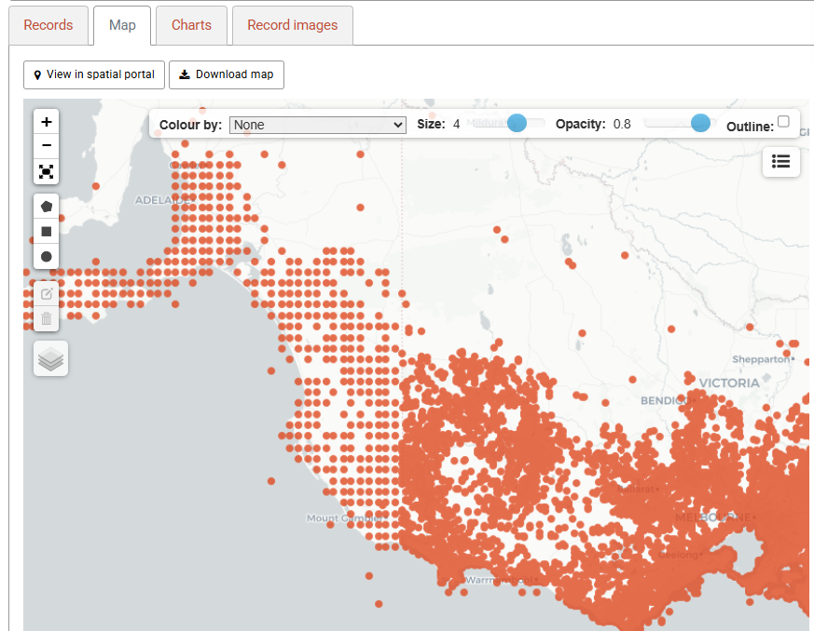

Sensitive Species
Sensitive Species Data:
are data about species that have features that mean there are reasons for withholding the data from public view or modifying the data before it is made public.
Our Task Group has started referring to Restricted Access Species Data
Because it is less likely to be confused with issues like government security levels
​

Slide 3
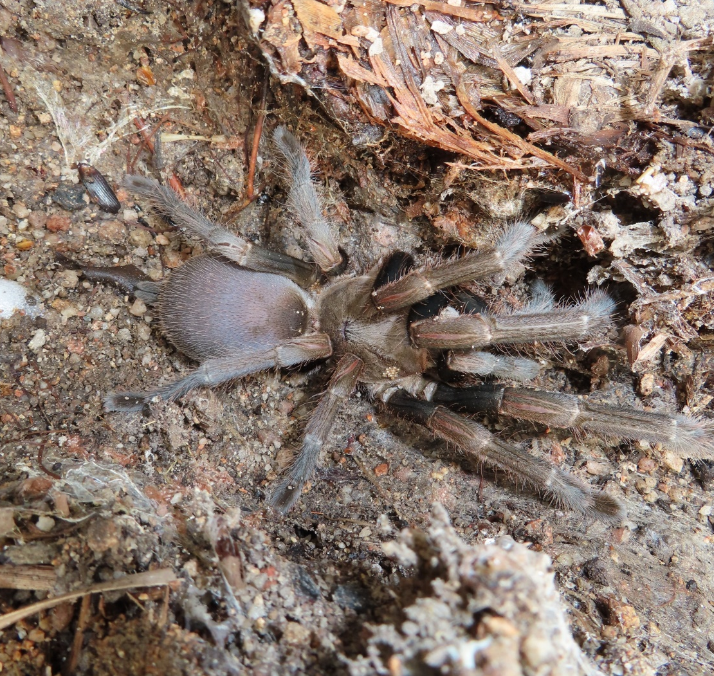
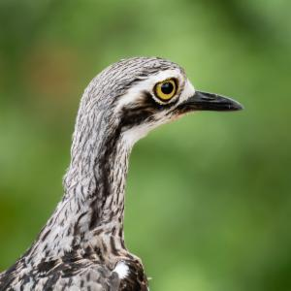
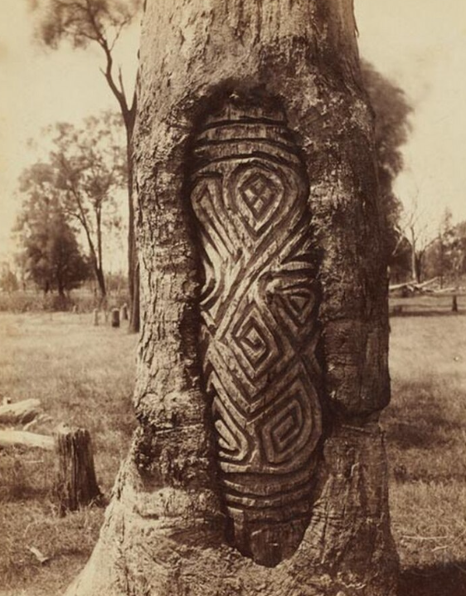
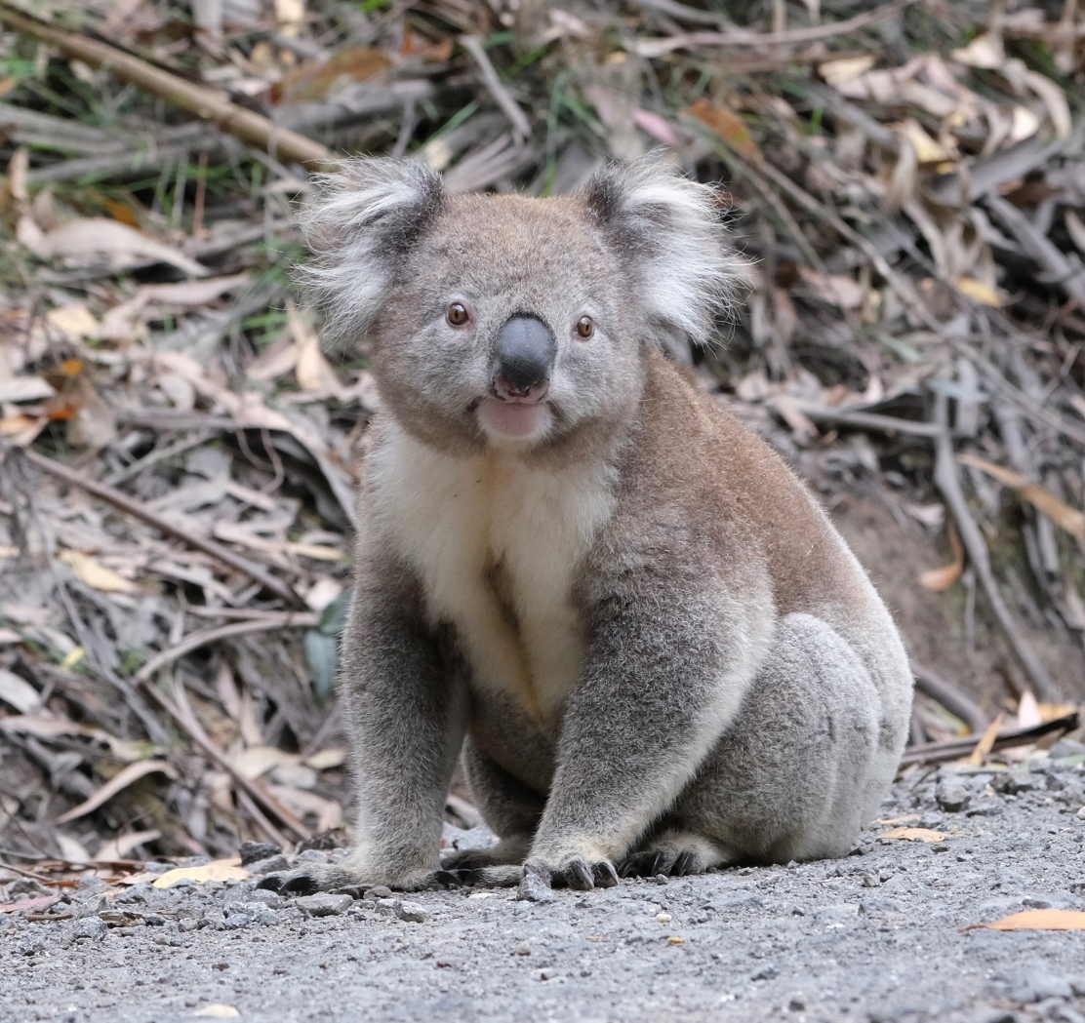
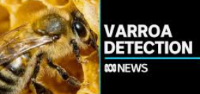
RASD versus Threatened Species
Sensitive Species
Threatened Species
Sensitive species:
May be rare, or even common, species whose appearance, management, value, habits, cultural significance or invasiveness make their locality information sensitive
Threatened Species are:
Those species listed as threatened under legislation
Bush Stone-Curlew
(Burhinus (Burhinus) grallarius)
Photo Credit Nicole Brooker
CC BY NC
Queensland Whistling Tarantula (Selenocosmia crassipes)
Photo Credit Scott Burnett
Koala
(Phascolarctos cinereus)
Photo Credit gggpellas CC BY NC

Slide 4
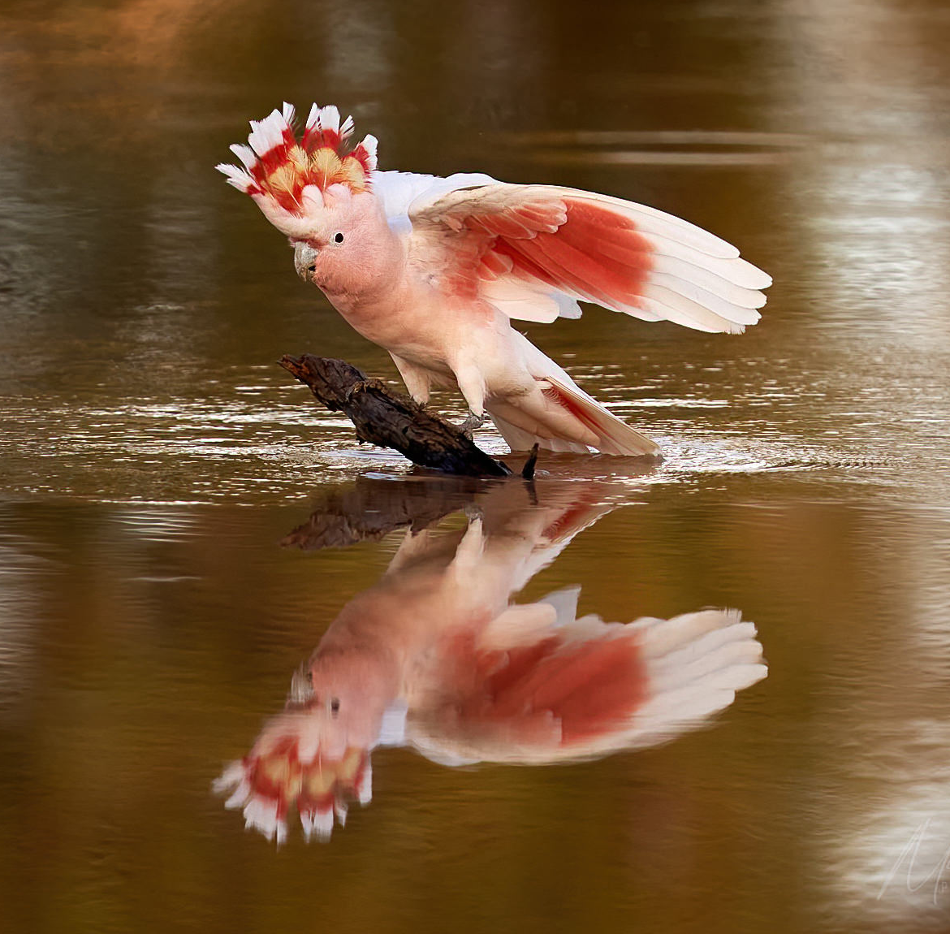
What are RASD Reasons?
Associations with other taxa
Scientific research publications
Risk to human life
Indigenous Ecological Knowledge
Site description
Life histories
Habitat information
Trespassing
Pest / weed control
Personal information
Pink Cockatoo
(Lophochroa leadbeateri ssp. leadbeateri)
Photo Credit Michael Hains
CC BY NC
Legal / non-legal reasons
Biosecurity taxa
Privacy
Illegal collection

Slide 5
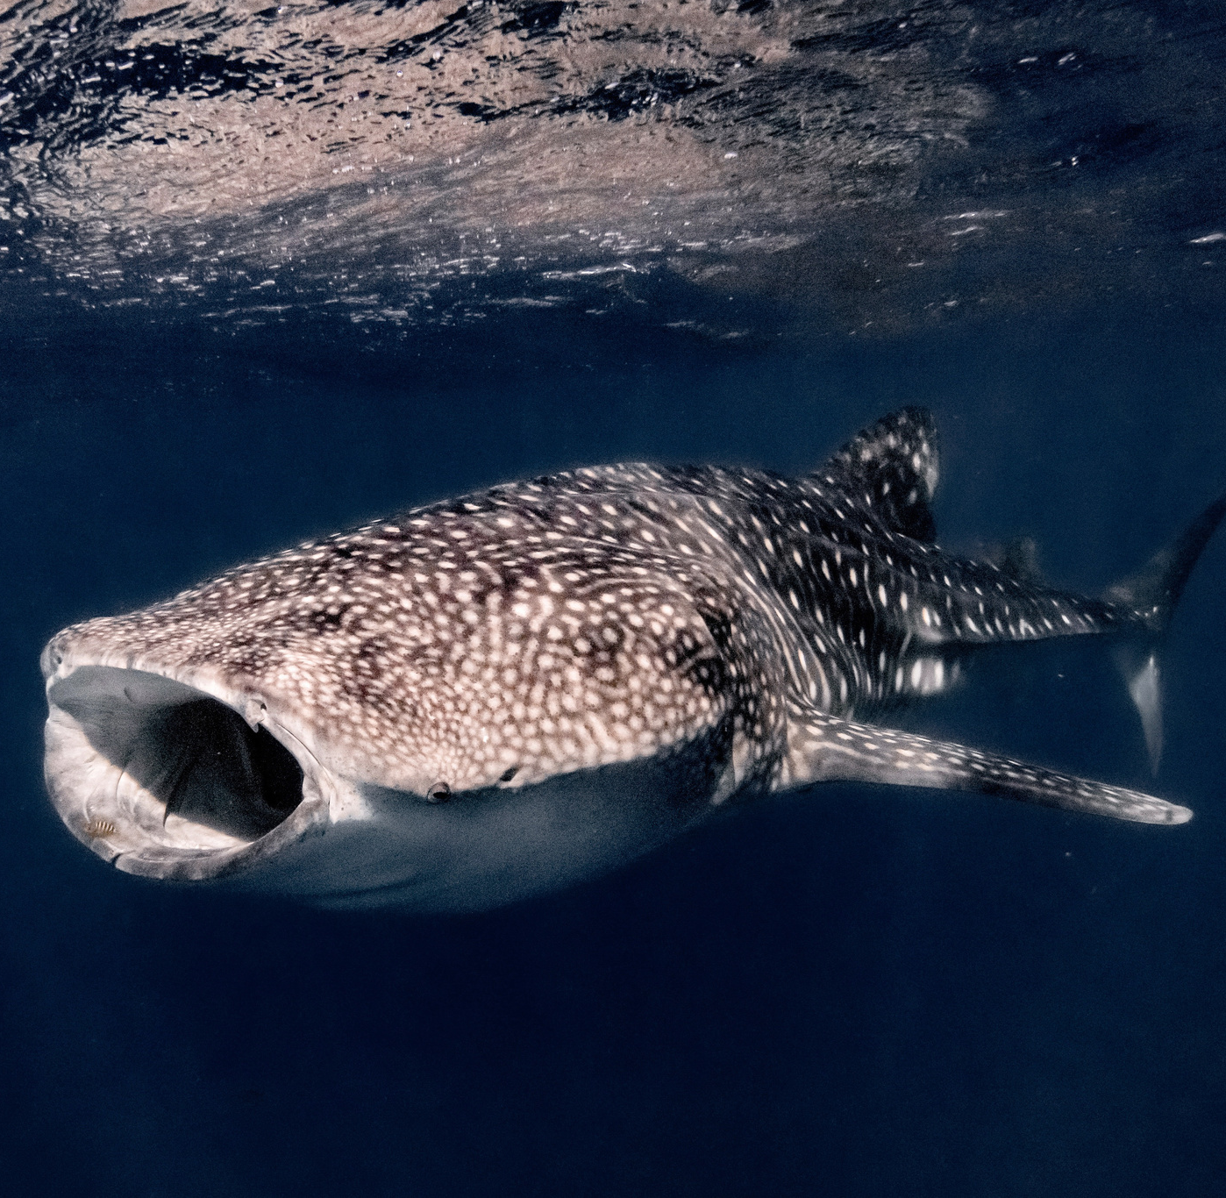
Reasons that Records Might Not Be RASD
Public availability of data
Low risk life history stages
Difficult to find
Low risk of poaching
Boletellus emodensis (Berk.) Singer
Photo: C. Slatyer
Whale Shark (Rhincodon typus)
Photo Credit valeriecornet CC BY NC

Slide 6
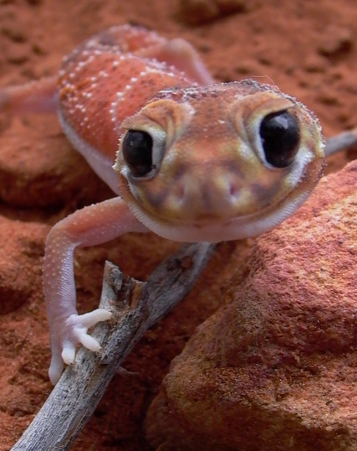
RASD Task Group
Arose out of a workshop at the 2023 TDWG Meeting:
  Develop a new DwC extension based on Chapman (2020) and make amendments to it based on the workshop discussion
  Define a set of sensitive fields similar to the pick lists for dataSensitiveReason (which is defined in Chapman 2020)
Convenors from Atlas of Living Australia, Gaia Resources and the Global Biodiversity Information Facility
Membership includes representatives from government, university, data providers and data aggregators from:
Australia
China
Denmark
Finland
France
Germany
Sweden
Netherlands
Taiwan
USA

Slide 7
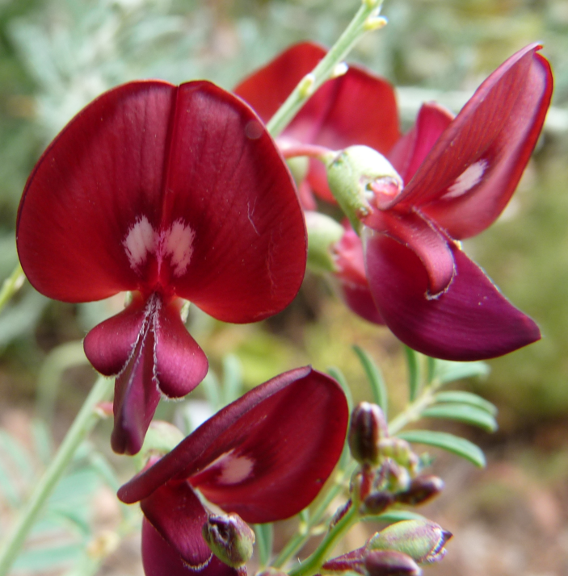
Where the RASD Task Group is up to:
The Task Group first met in September 2024
Meets more or less monthly - 11 meetings in total so far. Proposed vocabularies for RASD reasons and treatments have been developed, refined and given use cases from the Task Group from real world examples.
Two subgroups – one for DwC Native and one for DwC-Data Package have met 4 times to develop data models.
Now preparing draft documentation for the TDWG Maintenance Group

Slide 8
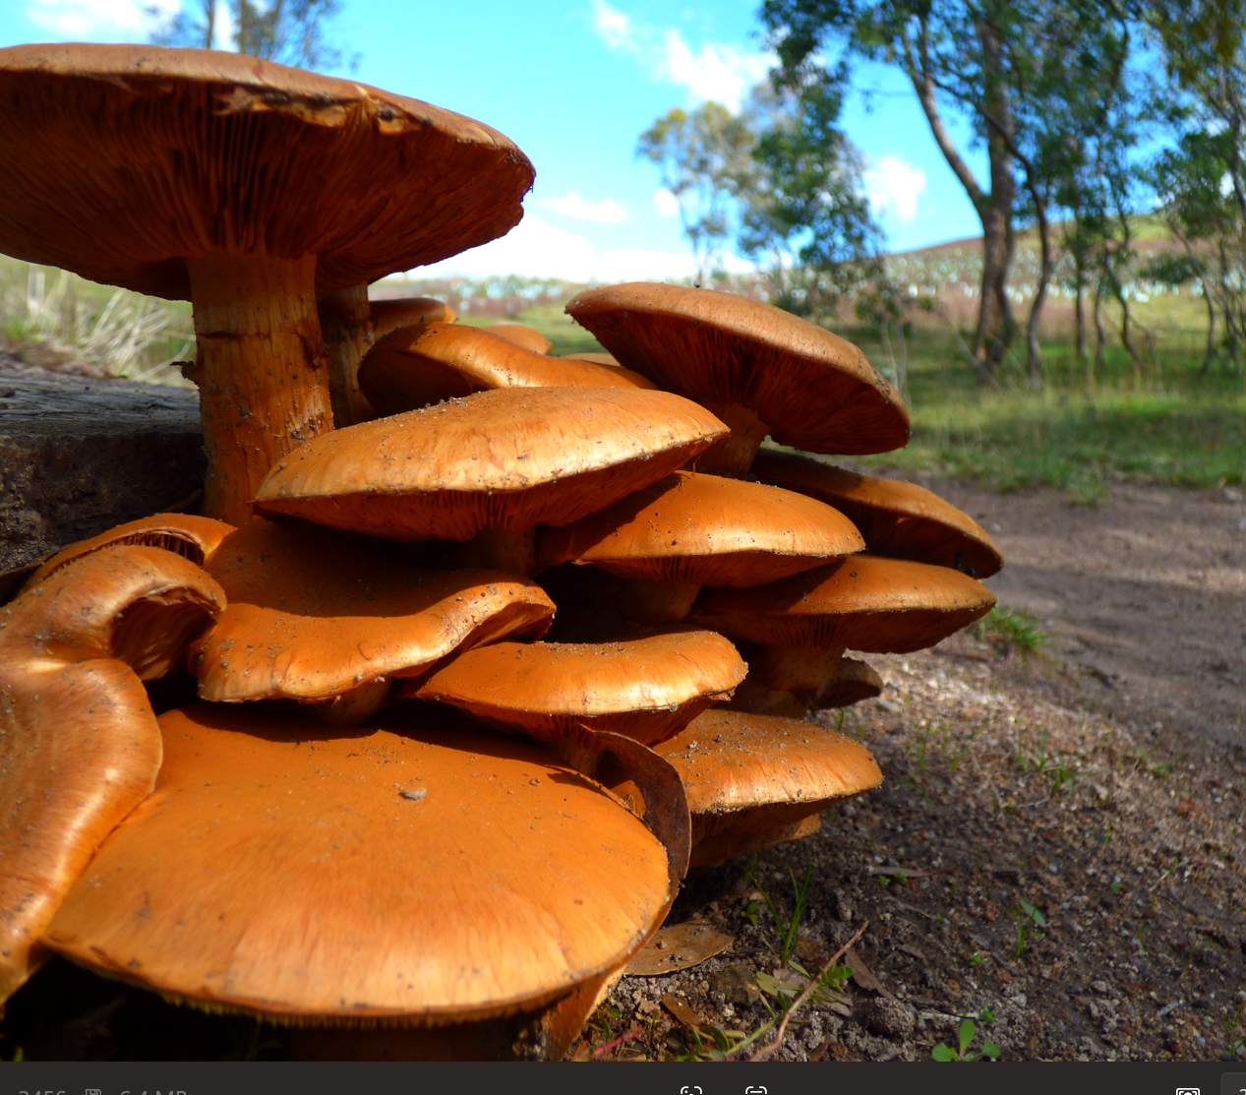
DWC RASD Extension
Vocabularies applied in a one-to-many relationship with a DWC record or dataset similar to the measurement of fact DWC extension
A RASD treatment needs a RASD reason associated with it. A RASD reason may require more than one treatment being applied. A record may also have more than one RASD reason and therefore treatment applied.
The purpose of having sub-categories are:
so that data custodians can comply with basic FAIR principles as they apply to restricted access species records; and
The extension can handle the breadth of restricted access species data management actions across multiple data custodians

Slide 9
RASD Reasons
Reasons for applying restrictions to the data:
personal information privacy
sensitive location
biosecurity risk
species attributes
usage-restrictions
first nations cultural significance
The presence of personal data – information, names or addresses compromise the privacy of individuals.
1.1 lack of consent
1.2 request for privacy
Information about the location or habitat of a species places that species at risk if data is not either withheld or generalised.
2.1 highly restricted species
2.2 threatened populations
2.3 cryptic locations
2.4 exposure via survey information
2.5 exposure via contextual attribute
2.6 potential harm to people or property
2.7 deficiency of information or resources
Information about biosecurity risk species may have negative implications.
3.1 trade sensitive species
3.2 invasive species
Species attribute information that is perceived to be restricted access.
4.1 physical attributes
4.2 taxonomic uncertainty
Restricted access due to legal or non-legal usage restriction agreements.
5.1 legal contract
5.2 non-legal reasons
Information that First Nations people consider to be restricted access
6.1 culturally significant species
6.2 culturally significant species information
6.3 culturally significant location

Slide 10
RASD Treatments
The treatment applied to the data to restrict access to information based on a reason.
A obfuscate coordinates
B generalise attributes
C generalise dates
D withhold data
Coordinates are obfuscated by generalisation, randomisation or by using polygons
A.1 coordinates truncated
A.2 coordinates replaced by standardised grid
A.3 coordinates randomised within a polygon
A.4 coordinates replaced by a centroid
Restricted attributes are generalised to a higher level where these attributes could expose information about a restricted access species.
B.1 generalise taxon level
B.2 generalise locality
Withhold information when generalising (obfuscating) is not sufficient to protect the species, personal integrity, survey integrity etc. as specified in the RASD reason category.
D.1 withhold records
D.2 withhold attributes
D.3 embargo dataset
D.4 embargo record
D.5 embargo attributes
D.6 withhold dataset
Dates are generalised to a less precise level where these dates could expose information about a restricted access species via inference.
C.1 generalised date to month
C.2 generalised date to year
C.3 generalised date to decade

Slide 11
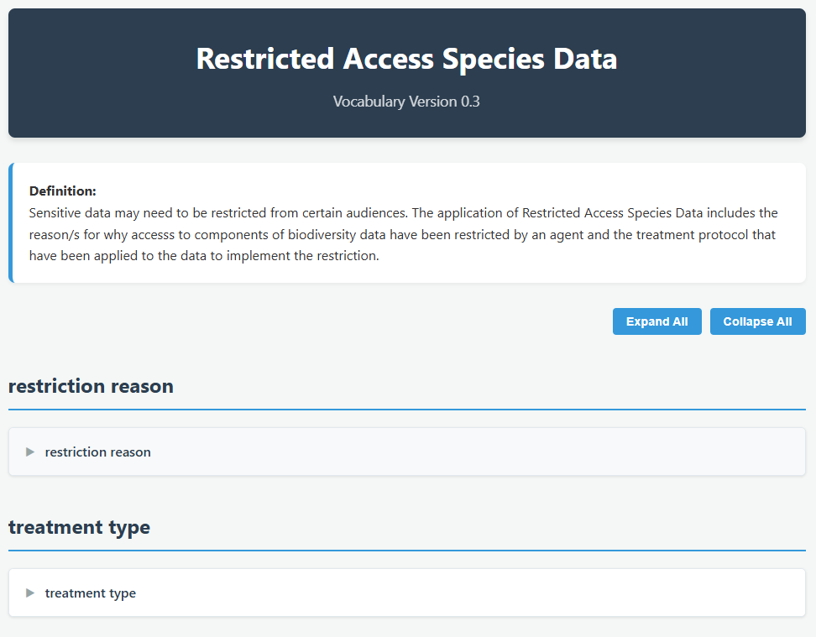
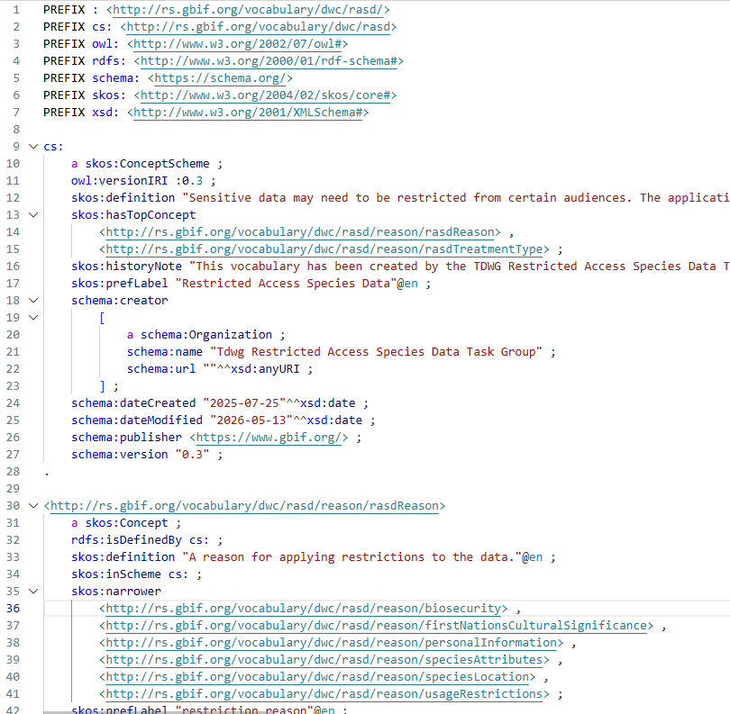
Treatments and Reasons

Slide 12
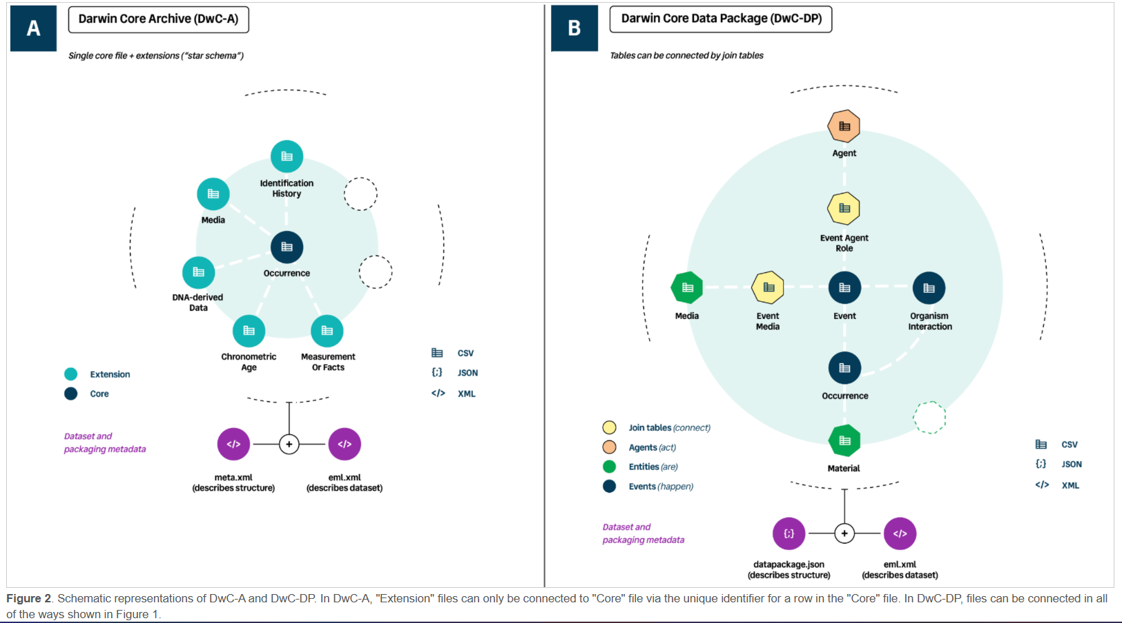
Data models DwC Native DwC Data Package
https://gbif.github.io/dwc-dp/qrg/#dwca
https://gbif.github.io/dwc-dp/qrg/#dwca

Slide 13
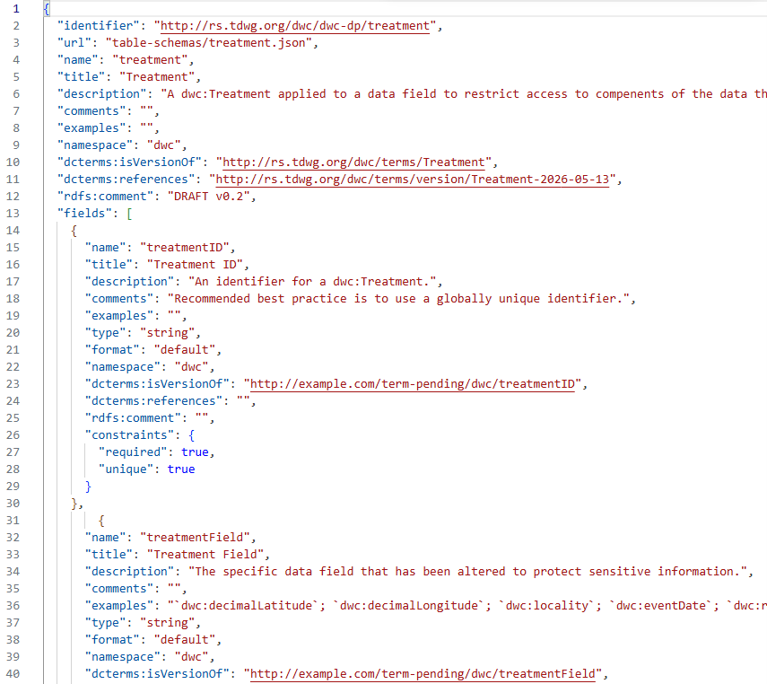
RASD schema

Slide 14
RASD schema
Field Name | Definition | Potential Values
treatmentID | An identifier for a dwc:Treatment | Integers, UUIDs
treatmentField | The specific data field that has been altered to protect sensitive information | IRI for the field
treatmentReason | A category that best matches the reason for the dwc:Treatment | IRI for the RASD Reason
treatmentType | A category that best matches the nature of a dwc:Treatment. | IRI for the RASD Treatment
treatmentDescription | Text description of the method applied to the data in making a dwc:Treatment. | Text
treatmentStartDate | A date on which a dwc:Treatment was deemed to first be in effect. | Blank if not applicable, otherwise a date to at least day precision in a standard format (e.g. ISO 8601)
treatmentEndDate | A date on which a dwc:Treatment will cease/ceased to be in effect. | Blank if not applicable, otherwise a date to at least day precision in a standard format (e.g. ISO 8601)
treatmentOrganization | Name of dcterms:Agent responsible for requiring the dwc:Treatment. | Should link to an entry in the person/organization section of the metadata.
treatmentInEffect | Boolean indicator for if the dwc:Treatment is the primary restriction currently in effect on the dwc:treatmentField. | Boolean.

Slide 15
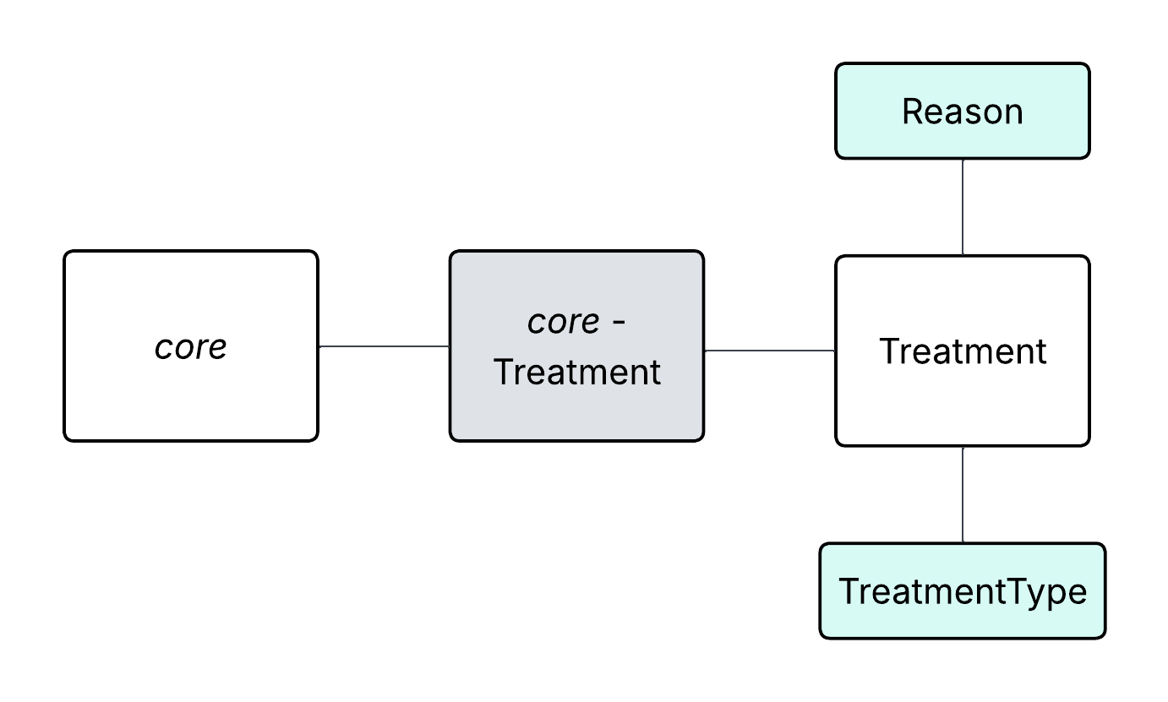
DwC Data Package

Slide 16
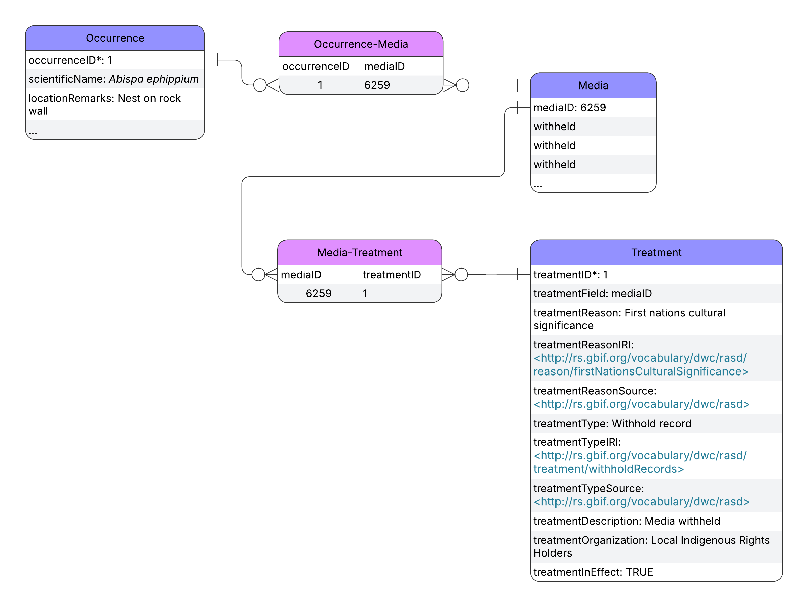
Implementation – Case study 1
An Indigenous community is concerned about culturally sensitive rock art appearing in the background of a photo-based species observation of a wasp nest of a regionally interesting species.
While there is nothing sensitive about the wasp nest record itself, the photo is highly sensitive.

Slide 17
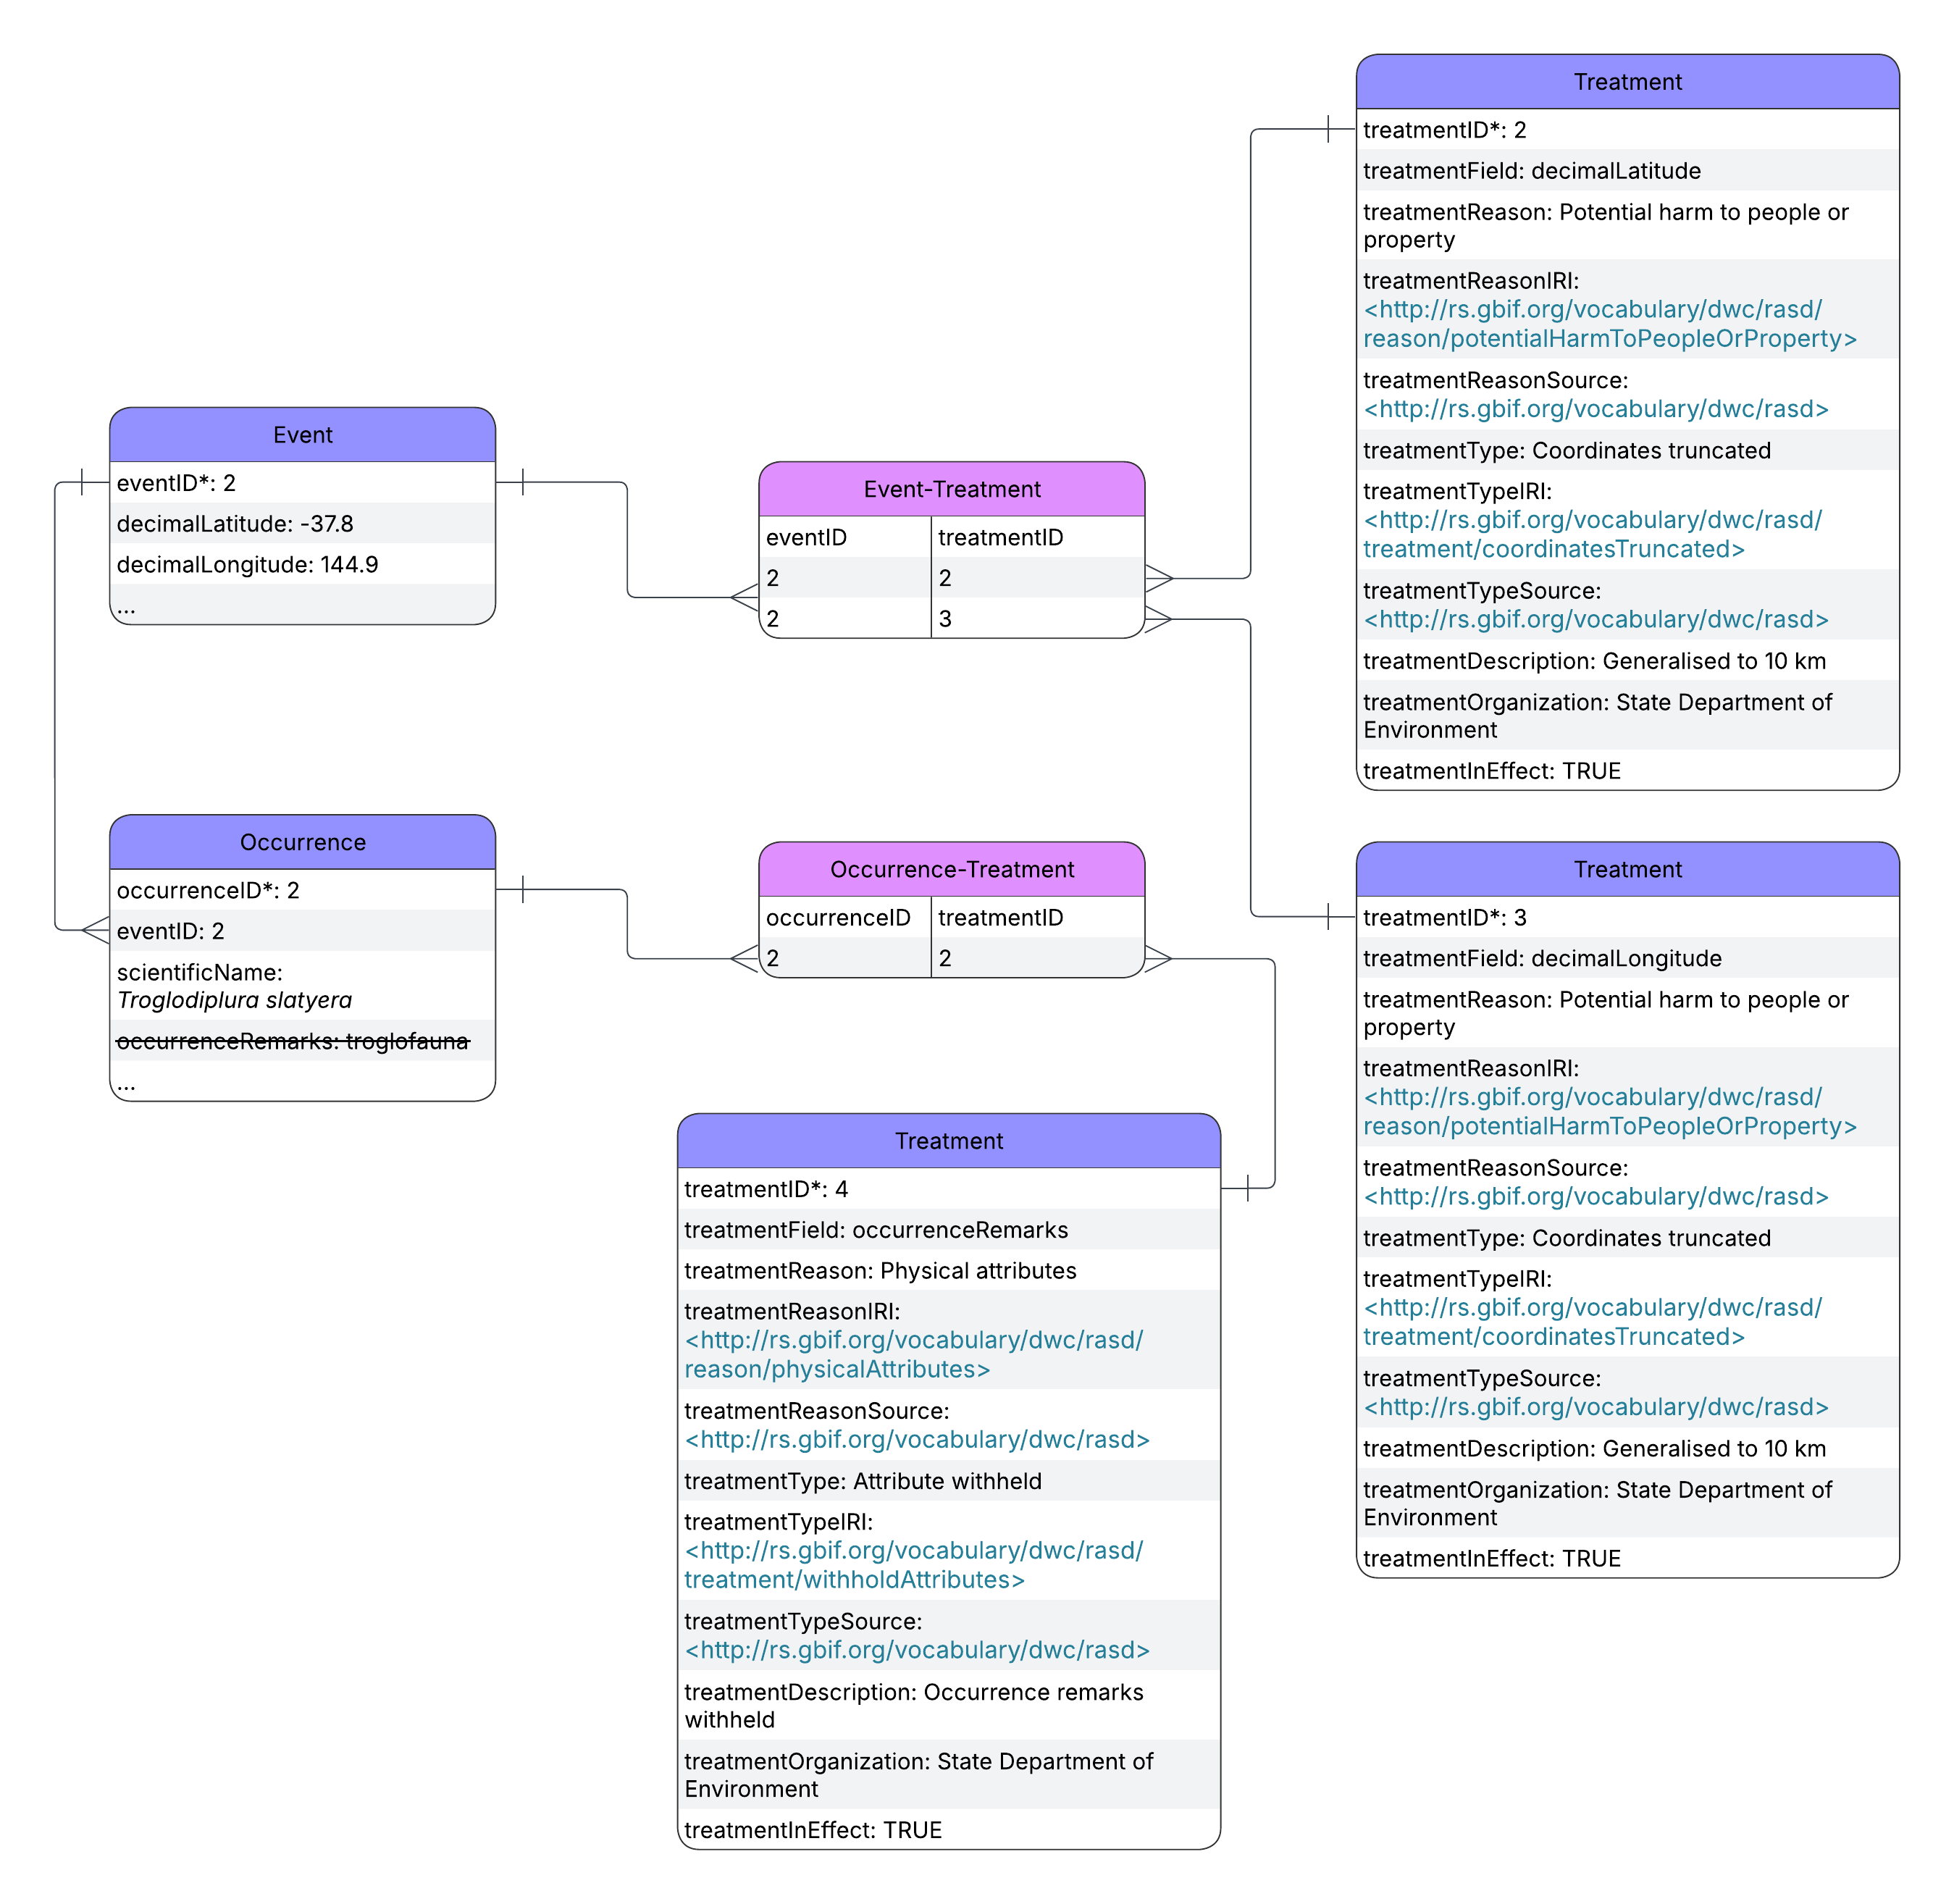
Implementation – Case study 2
A new cave is discovered. In the cave, a well-known species of troglobitic spider is found, several new species of mites, and also extremely rare sub-fossils of a now extinct species. The area is used by enthusiastic amateur cavers and fossil hunters, who have had a history of using biodiversity databases to find caves, stealing fossils and damaging caves habitat. There are three issues. i) the cave as a locality is sensitive, ii) While there is nothing significant about the spider record, the fact that it is troglobitic reveals where the cave is as an associated record, iii) the fossil and new species of mites (also troglobitic) are sensitive.

Slide 18
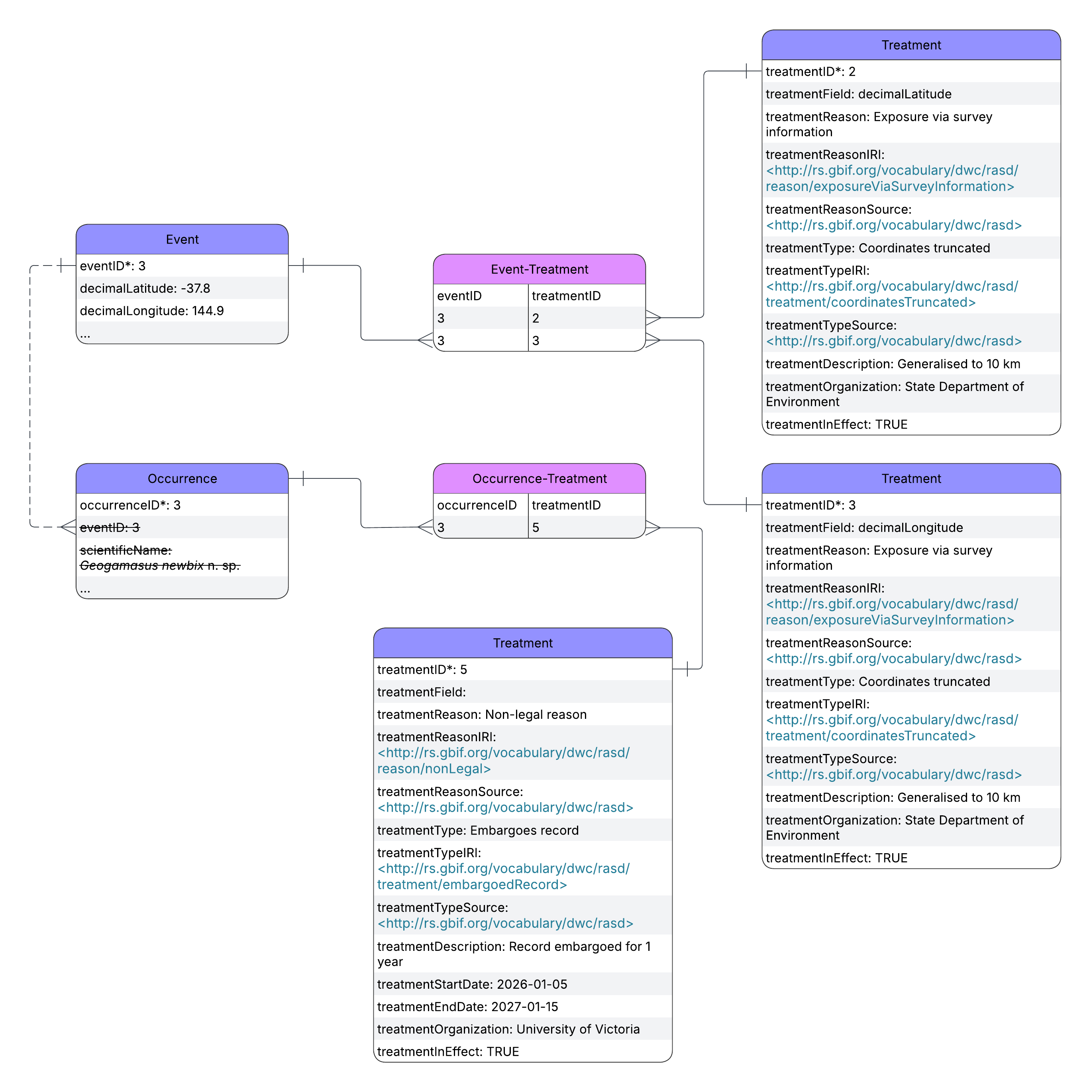
Implementation – Case study 2
A new cave is discovered. In the cave, a well-known species of troglobitic spider is found, several new species of mites, and also extremely rare sub-fossils of a now extinct species. The area is used by enthusiastic amateur cavers and fossil hunters, who have had a history of using biodiversity databases to find caves, stealing fossils and damaging caves habitat. There are three issues. i) the cave as a locality is sensitive, ii) While there is nothing significant about the spider record, the fact that it is troglobitic reveals where the cave is as an associated record, iii) the fossil and new species of mites (also troglobitic) are sensitive.

Slide 19
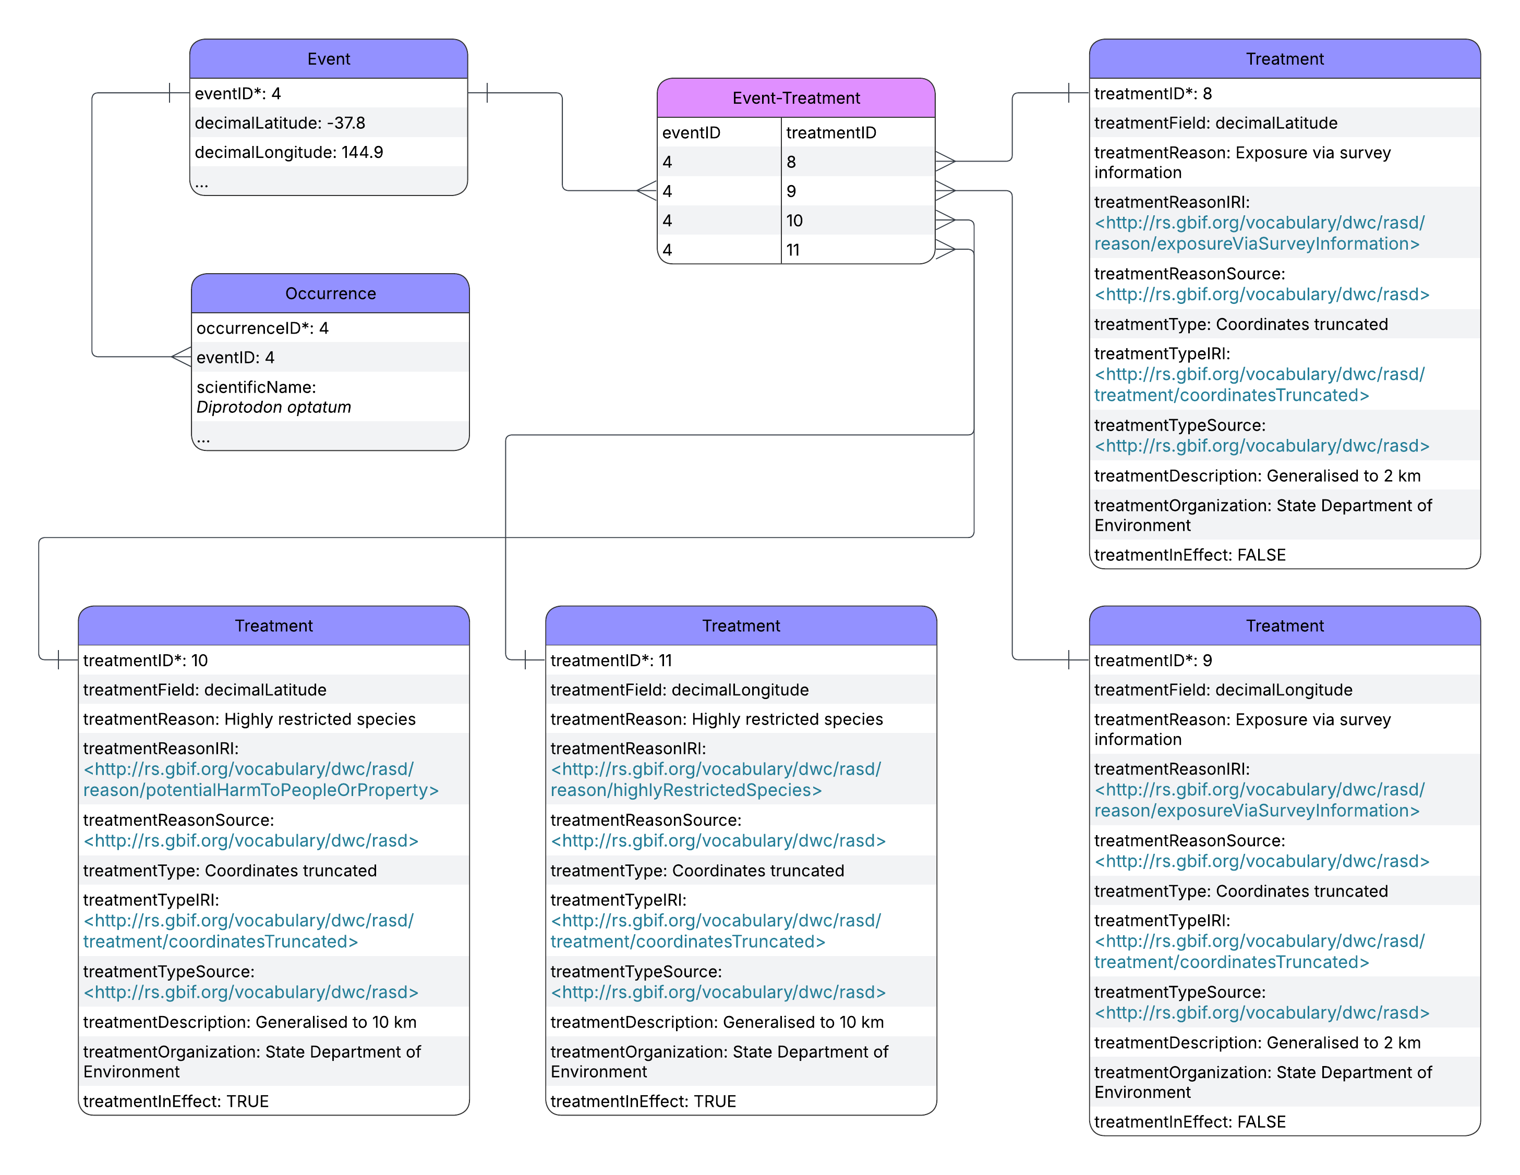
Implementation – Case study 2
A new cave is discovered. In the cave, a well-known species of troglobitic spider is found, several new species of mites, and also extremely rare sub-fossils of a now extinct species. The area is used by enthusiastic amateur cavers and fossil hunters, who have had a history of using biodiversity databases to find caves, stealing fossils and damaging caves habitat. There are three issues. i) the cave as a locality is sensitive, ii) While there is nothing significant about the spider record, the fact that it is troglobitic reveals where the cave is as an associated record, iii) the fossil and new species of mites (also troglobitic) are sensitive.

Slide 20
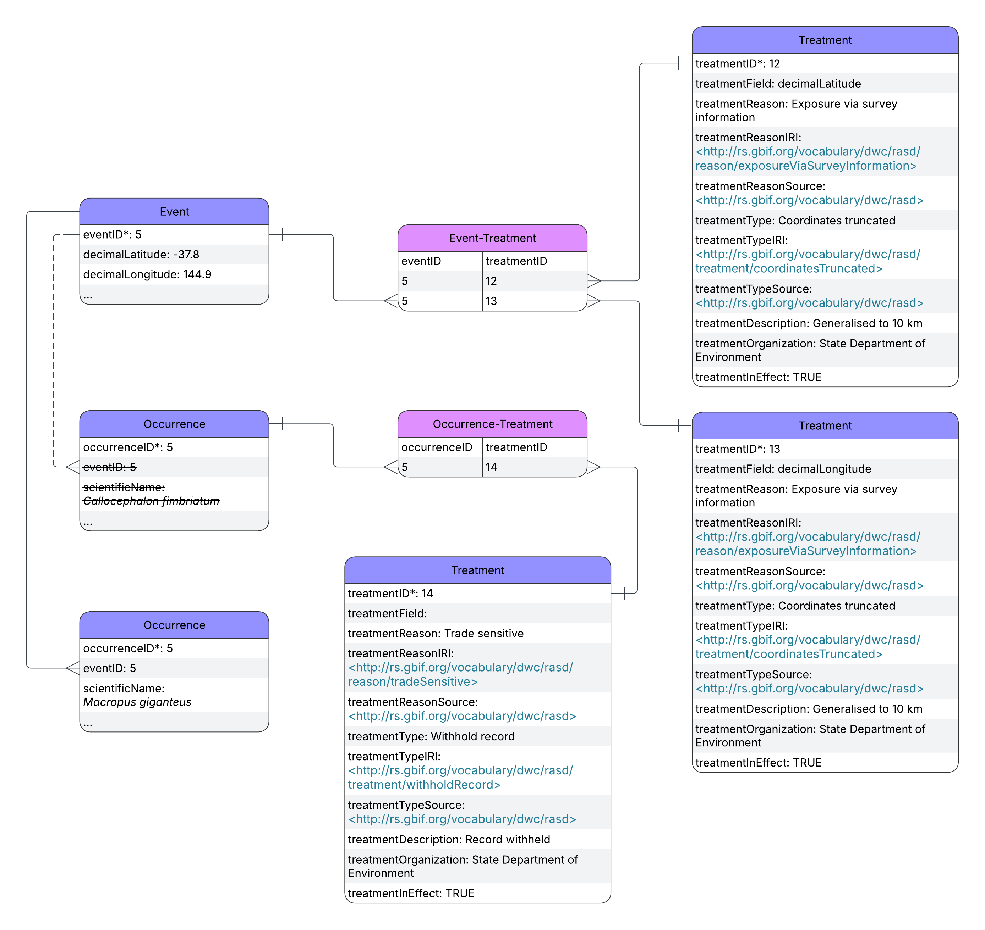
Implementation – Case study 3
A new camera trap project wants to share data publicly. Some of the camera traps include images of both common species and species in demand by poachers for the pet trade. The issue is that because the camera traps act as events in event data, any solution must account for the fact that it is the event, not the photo, that is potentially sensitive

